Slide 1
Marine Corps
Installations East
Business Outreach
18 November 2021
CUI
1

Slide 2
Event Purpose
Purpose: The purpose of this event is to: (1) educate businesses on the fundamentals of doing business with the Government, (2) inform businesses on how the contracting organizations communicate their requirements (solicitations) to businesses, (3) identify how the chambers of commerce/community colleges/North Carolina Military businesses centers support businesses.
Method: Conduct a one-day seminar consisting of briefs contracting activities, chambers of commerce, community colleges and North Carolina Military Business Center. The intent of these briefs is to provide: (1) a basic overview on how each contracting office communicates requirements (solicitations), (2) how the chambers of commerce and community colleges educate and support businesses doing business with the Government,. (3) how the North Carolina Military Business Center supports business.
Endstate: (1) Provide the best possible information to businesses in order to enable them to be as competitive as possible for Government contracts, (2) inform the contracting offices, chambers of commerce, community colleges and North Carolina Military Business Center collaborate to enable businesses to be competitive.
CUI
2

Slide 3
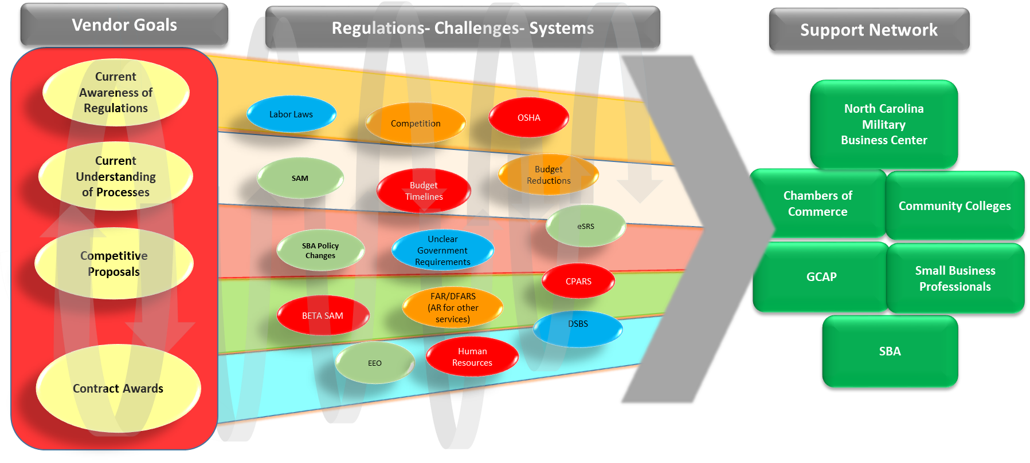
The Business Environment
What you are up against!
Plus!
Economic Fluctuations (COVID, Housing, Interest Rates, Force Changes)
Staffing Challenges
Supply Chain Challenges
CUI
3

Slide 4
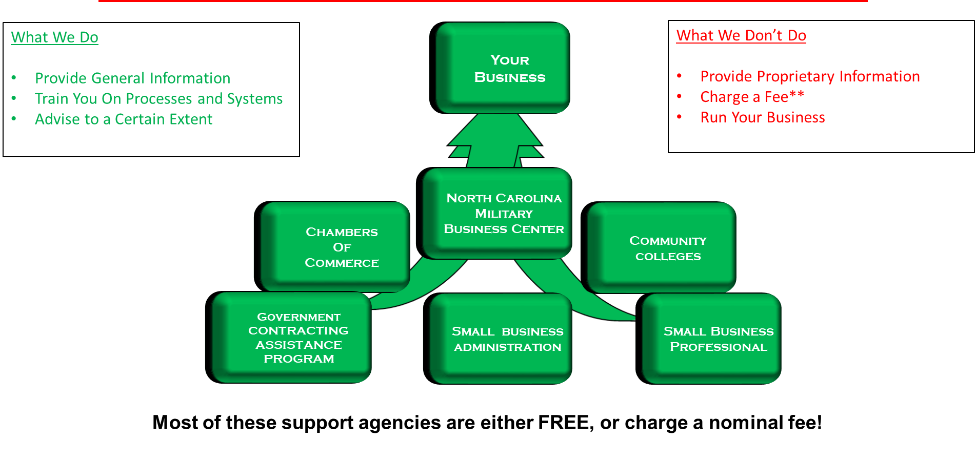
Government Contracting Environment
CUI
4

Slide 5
Supporting Office Briefs
Coastal Carolina Community College
North Carolina Military Business Center
Government Contracting Assistance Program
Jacksonville-Onslow Chamber of Commerce
CUI
5

Slide 6
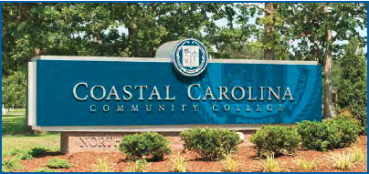
Southeastern North Carolina Military Business Outreach
Doing Business with Camp Lejeune
Brief by Coastal Carolina Community College Small Business Center
November 18, 2021
6

Slide 7


Who We Are…
The Small Business Center at Coastal Carolina Community College
  Our mission
  Our services
  Our results
  Our team
7
Notes:
Hello everyone and welcome to today’s big event. We are pleased to join our partners in the entrepreneurial and government contracting support eco-system to share with you briefly who we are and what we do. For the next 10 minutes I’ll introduce you to the Coastal Carolina Community College Small Business Center, sharing information about our mission, our services, our results, and our team.

Slide 8
Small Business Center- Who We Are
  SBCN established by the General Assembly in 1984
  More than 37 years of experience with a proven track record of assisting businesses
  Coastal’s SBC began operations in 1986
  Footprint of 58 SBCs across the state with 60 locations
  Professional, Experienced Business Counselors
  Start Businesses
  Create and Retain Jobs
Mission:
The goal of the Small Business Center Network (SBCN) is to increase the success rate and the number of viable small businesses in North Carolina by providing high quality, readily accessible, no-cost assistance to prospective and existing small business owners, leading to job creation and retention. Each Small Business Center (SBC), one located at each of the 58 community colleges, is a community-based provider of education and training, counseling, referral and information.
8
Notes:
Thank you for the opportunity to share information about Coastal Carolina Community College’s Small Business Center
The Small Business Centers were established by the General Assembly in 1984 with the initial establishment of 8 SBCs and expansion to all 58 colleges by 1995.
For those of you in the audience who are doing that math, that means that the SBCN has been providing services to our state’s entrepreneurs for more than 37 years, with a proven track record of guiding them to successful start-up and growth of their enterprises.
In simplest terms, our mission is to help North Carolinians pursue their dreams of starting their own businesses and through that effort, to create and retain jobs for our State. We are very proud to be the largest, state funded small business assistance program in North Carolina, reaching all 100 counties through our 58 community colleges, as well as creating economic impact in all 100 counties.

Slide 9


PIEDMONT/TRIAD REGION
Martha Larson, Regional Director
Davidson-Davie Community College
PO Box 1287
Lexington, NC 27293
(336) 224-4557
martha_larson@davidsondavie.edu
NORTH CENTRAL REGION
Cherith Roberson, Regional Director
Wake Technical Community College|West Campus
3434 Kildaire Farm Road
Cary, NC 27518
(919) 335-1007
croberson@waketech.edu
NORTHEASTERN REGION
Ginger O’Neal, Regional Director
College of the Albemarle
PO Box 2327
Elizabeth City, NC 27906
(252) 335-0821 x2370
ginger_oneal@albemarle.edu
NORTHWEST REGION
Jeff Neuville, Regional Director
Catawba Valley Community College
2664 Highway 70 SE
Hickory, NC 28602
(828) 327-7000, x4102
jneuville@cvcc.edu
Alleghany
Warren
Ashe
Surry
Stokes
Gates
Currituck
Rockingham
Caswell
Person
Vance
Northampton
Hertford
Camden
Watauga
Wilkes
Granville
Halifax
Pasquotank
Yadkin
Forsyth
Perquimans
Avery
Guilford
Orange
Franklin
Bertie
Chowan
Mitchell
Caldwell
Davie
Alamance
Durham
Nash
Madison
Yancey
Alexander
Edgecombe
Tyrrell
Burke
Iredell
Davidson
Randolph
Chatham
Wake
Wilson
Martin
Washington
Dare
Haywood
Buncombe
McDowell
Catawba
Rowan
Johnston
Pitt
Beaufort
Swain
Rutherford
Lincoln
Cabarrus
Lee
Harnett
Greene
Hyde
Graham
Jackson
Cleveland
Stanly
Wayne
Henderson
Montgomery
Moore
Cherokee
Macon
Transylvania
Polk
Gaston
Mecklenburg
Lenoir
Craven
Pamlico
Clay
Union
Anson
Richmond
Hoke
Cumberland
Sampson
Duplin
Jones
Scotland
Onslow
WESTERN REGION
Jill Sparks, Regional Director
Asheville-Buncombe Technical Community College
1465 Sand Hill Road, Suite 1060
Candler, NC 28715
(828) 398-7949
jillmsparks@abtech.edu
SOUTHWEST REGION
Renee Hode, Regional Director
South Piedmont Community College
4209 Old Charlotte Hwy
Monroe, NC 28110
(704) 290-5218
rhode@spcc.edu
Robeson
Carteret
Bladen
Pender
SOUTHEAST REGION
Jerry Coleman, Regional Director
Cape Fear Community College
411 N. Front Street
Wilmington, NC 28401
(910) 362-7469
jdcoleman338@mail.cfcc.edu
SANDHILLS REGION
Todd Lyden, Regional Director
Bladen Community College
PO Box 266
Dublin, NC 28332
910-879-5572
tlyden@bladencc.edu
Columbus
New Hanover
Brunswick
Anne Shaw, State Director
NC Community Colleges
910-545-3679 – cell
910-938-6319 – office
shawa@nccommunitycolleges.edu
Mark Hagenbuch, Deputy Director
Guilford Technical Community College
Nussbaum Center for Entrepreneurship
1451 South Elm Eugene Street
Greensboro, NC 27406
(336) 334-4822 x62003
mthagenbuch@gtcc.edu
October 2021
9
Notes:
This map provides a visual for how the Centers are organized across the state As shared previously, all 58 North Carolina Community Colleges have a Small Business Center. And fortunately, each of those SBCs is conveniently located within a 30 minute drive of anyone living in North Carolina and with Zoom and other virtual technology, we are easily accessible for all of our services. We have a total of 8 regions. Each region is supported by a volunteer Regional Director who supports the Directors in his or her region by providing help with onboarding as well as ongoing mentorship. The Regional Directors, along with 4 committee chairs and 1 special projects chair make up the SBCN Leadership Team.
Committees are: Policy and Procedures; Programming; Marketing; Professional Development

Slide 10

Who We Help
Prospective entrepreneurs, beginning stage and existing small business owners
Majority of clients are in the pre-venture stage when they first seek our assistance
Client Characteristics: 59% Females, 38% Minorities, 11% Veterans
10
Notes:
Here we share some information about the clients we serve and how our program is administered.
The Small Business Center Network provides services to prospective entrepreneurs, clients who are in the early start-up phase of their businesses, and we also serve existing small business owners. The greatest majority of our clients are in the very early “pre-venture” stage when we first meet with them. They may have an idea for a business they want to start and need guidance to determine the feasibility of the idea. They frequently need help with the creation of a business plan. In many cases, they have been laid off from a job and want to explore entrepreneurship as a way of creating a job for themselves and others. They may have just started a business and realize they need to learn more about their tax requirements or how to better reach their target market or any of a number of business-related topics +. While we assist clients at whatever stage they find themselves with their business, we spend most of our time helping early stage businesses.
In terms of our client profile, we’re seeing a split of 59% females and 41% males; over a third of them are minorities and at least 11% of our clients are military veterans.

Slide 11



How We Help Businesses – Trio of Services
Business Counseling
Start-up or Growth
1:1
Confidential
FREE
Training
Core Topics
Supplemental Topics
High Impact
Short Duration
FREE
Resource Information
& Referral
Tools to launch and scale
Templates, Industry Data
Referrals to Agencies & Professionals
FREE
11
Notes:
2-3 Minutes
Here I’ll share information about how the Small Business Center helps businesses
Starting a business, from the very early “idea” stage to the actual start-up of the business, can be a very confusing and challenging process and we know that many businesses fail because the owner did not carefully explore the start-up and business planning process. Our primary objectives in working with new entrepreneurs are to simplify the start-up process, help them navigate the requirements of the various federal, state and local regulatory agencies and give them the greatest potential for success to start their businesses, grow their businesses and create jobs.
Our spectrum of services includes three primary avenues of working with clients: The first is the provision of free, confidential business counseling; the second service we offer is training in the form of seminars and short-term classes. These seminars and classes are offered on a variety of topics and are also provided free of charge or for a very low registration fee; the third service we offer is the provision of resource and referral information, also on a variety of start-up and small business management topics. This includes referrals to our North Carolina Military Business Center for specialized assistance with military and federal procurement, as well as to other Federal, State, and local agencies as needed.

Slide 12


Experienced Business Counselors are available to help with:
General Business Counseling
Business Plan Development
Government Procurement
Sources of Capital and Loan Preparation
Marketing Assistance
International Trade
Operations & HR Management
12
Notes:
Our clients come to us at every possible stage of business ideation and development. They bring their questions and their problems, and we help them assess their current situation and drill down into a step-by-step plan for starting their business. Our business counselors have significant business ownership experience, non-profit management experience, experience in small business loans and other forms of financing, marketing and social media expertise….and if there is something we don’t personally know, we have an entire network of experienced business counselors and resource partners to turn to for those answers our clients are seeking.

Slide 13

Core Seminars
How to Start a Business
How to Write a Business Plan
How to Find Your Customers
Marketing Your Business
Basics of Bookkeeping
Small Business Taxes
Financing Your Small Business
13
Notes:
A major emphasis of our service offerings are the seminars we offer to help start, grow and sustain businesses. We start with the fundamentals – these 7 Core topics – starting a business, writing a business plan, identifying and targeting your customers, marketing strategy and advertising, bookkeeping, taxes, and the biggie – how to get financing for your business.

Slide 14

And, just a few specialty programs:
Doing Business with the Federal Government
8 (a) Certification
Women-Owned Business Certification
Getting Paid by the Government – WAWF
Side Hustle Saturday
Financial Fortitude in Action
Youth Trades Entrepreneurship Conference
14
Notes:
And, we supplement our Core programming with a number of specialty programs, designed to meet the unique needs of the local Onslow County market. Not surprisingly, since Coastal’s Small Business Center is located in a community that is home to the largest amphibious marine training base in the galaxy and an air station that is home to the Osprey and an impressive array of helicopters, we provide training to businesses who help to supply and support the needs of the installations – you – the people in this audience!

Slide 15
Our Three Year Performance
July 2018 – June 2021
  69 Businesses Started
  760 Jobs Created & Retained
  483 Seminars
  6,074 Total Attendees
  701 Businesses Counseled
  2,071 Counseling Hours Provided
15
Notes:
Allow me to wrap up with some final information, including these impressive results generated by the Coastal SBC team. In the last three years, through our counseling, training and resource and referral services, we were able to help start 69 businesses and create and retain 760 jobs. We offered 483 seminars and webinars, with more than 6,000 attendees. We provided confidential business counseling to 701 businesses, investing over 2,000 hours in boosting their efforts.

Slide 16


Don’t Want to Miss Anything?
16
Notes:
We also want to make sure that you know how to receive information about our upcoming programs – to opt into our newsletter, just text 22828 to CCCCSBCNEWS. You’ll receive information about our events and tips and information to help you start and successfully operate your business.

Slide 17


Our Team
Steve Gill
gills@coastalcarolina.edu
Scott Riggs
riggsr@coastalcarolina.edu
April Priester
priestera@coastalcarolina.edu
Carla Gavre
gavrec@coastalcarolina.edu
Anne Shaw
shawa@coastalcarolina.edu
17
Notes:
Finally, and before we leave the platform, I want to introduce the people who do all the heavy lifting to support Onslow County small business owners – our team is small but mighty – Steve Gill, business counselor and trainer for Boots to Business and other business start-up seminars; Scott Riggs, our amazing expert on all things business finance; April Priester, the Assistance Small Business Center Director, who also provides counseling expertise for a variety of business topics, and Carla Gavre, the backbone of our office operations. This is our team and we are here to serve.

Slide 18
North Carolina military business center
NCMBC Overview presented to:
Southeastern North Carolina
Military Business Outreach
WWW.NCMBC.US
18 NOV 2021
18

Slide 19

Military Impact
Total annual military impact*
$66 billion in Gross State Product: 12.8% GSP (2d largest sector)
Over 578,000 jobs impacted: $34 billion, personal income
Military/civilian payroll: $19.2 billion
Veteran payments, benefits: $8.2 billion
Federal contracts (FY2020)**
FED prime contracts: $9.52 billion
DoD prime contracts: $6.10 billion
*”The Economic Impact of the Military on North Carolina,” NC Department of Commerce, 2015
**Federal Procurement Data System, now beta.SAM.gov, as of 06 JAN 2021
19

Slide 20

Defense Business
Prime contracts, DoD in NC: $6.10 billion (83 Counties):
Prime contracts, federal in NC: $9.52 billion (97 Counties)
*2020 Data: FPDS, as of 03 MAR 2021
20

Slide 21
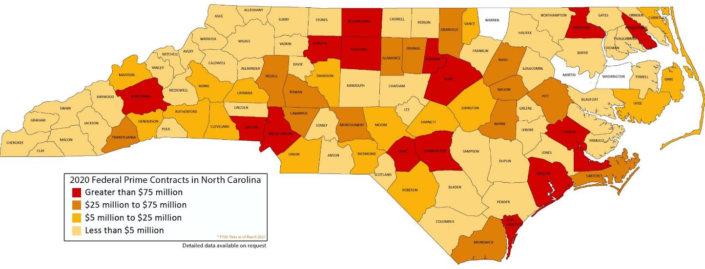
Federal Procurement
21

Slide 22
Who We Are
The NCMBC is a statewide, business development and technology transition asset of the NC Community College System, headquartered at Fayetteville Tech
Totally State-funded, the NCMBC is the only statewide, military-focused economic development entity in the US, and the only NC agency solely focused on growing the defense economy through existing industry
22

Slide 23
Mission, Goals and Outcomes
Mission: To leverage military and federal business opportunities to expand the economy, grow jobs and improve quality of life
Goals and Operations
1 - Increase federal revenues for businesses
2 - Support integration of military into workforce
3 - Support defense-related business recruitment
4 – Support technology transition to federal agencies
Outcomes: Contracts (4,166), revenues ($16.2b), jobs!
23
Notes:
Military impact in NC
MILCON in NC: Fourth state in country

Slide 24
Support Infrastructure
Networking
Strategic, Recruitment:
EDPNC/NCDoC
Operational, BD, (Current/Future): NCMBC
Advocacy
Teaming
Tactical, Develop Businesses:
SBA, SBCs, SBTDC, GCAP
NCVetBiz, Defense Alliance, Chambers, etc.
24
Notes:
Military impact in NC
MILCON in NC: Fourth state in country

Slide 25
Operations and Outcomes: BD Team
Operations: Business Development
Future Opportunities | Current Opportunities | Events
Market Intelligence | Solicitation Support | Training
Pre-positioning | Proposal Support | Counseling
Teaming | Subcontracting | Contract Execution
CY2005 - 2021 | 4,166 contracts | Min value: $16.2 billion
25
Notes:
Military impact in NC
MILCON in NC: Fourth state in country

Slide 26
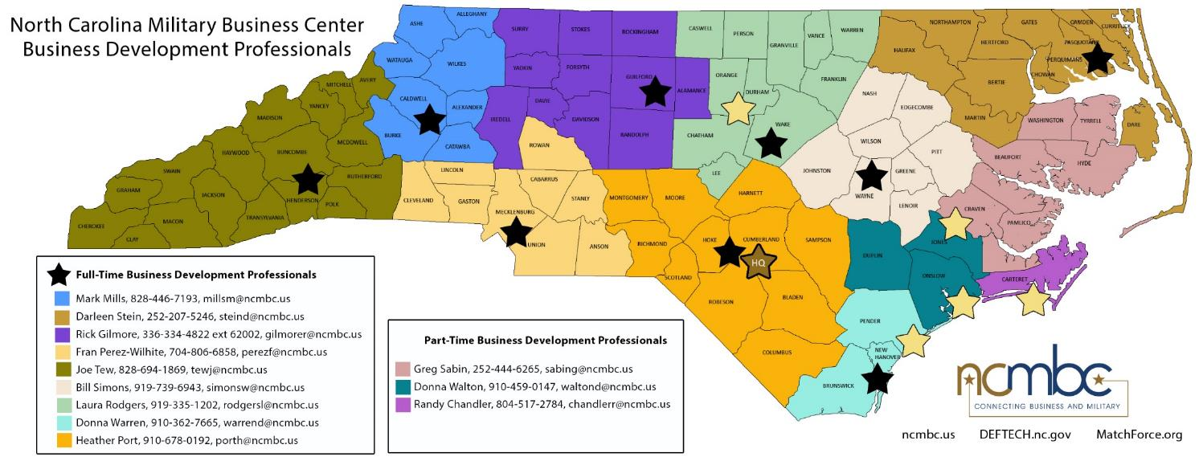
Operations: Business Development
26

Slide 27
Operations and Outcomes: MatchForce
MatchForce Next Generation is coming – DEC 2021!
Matches businesses to current, future federal opportunities
Matches contracting staff & GPC holders to NC businesses
Matches prime contractors to NC subcontractors
Businesses won >$5.51 billion, 2006-2021 contracts
Currently on MatchForce.org:
23,339 NC Businesses | 30,000+ Contract Opportunities
27

Slide 28
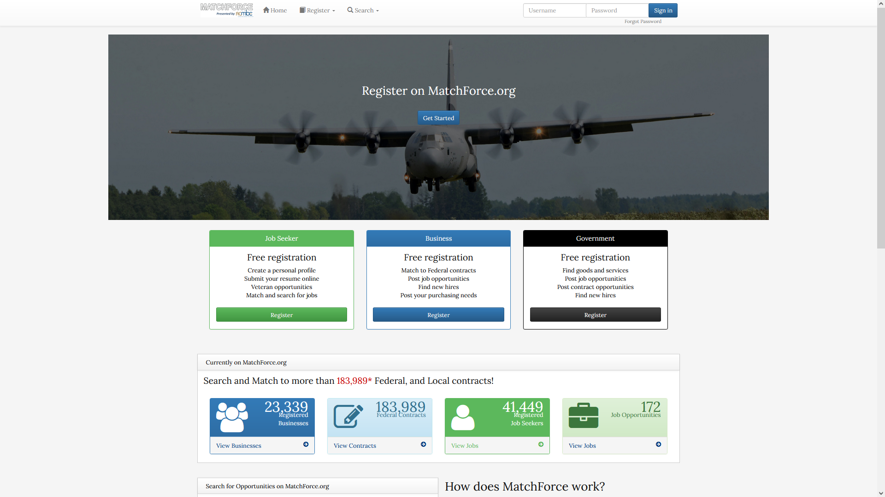
28

Slide 29
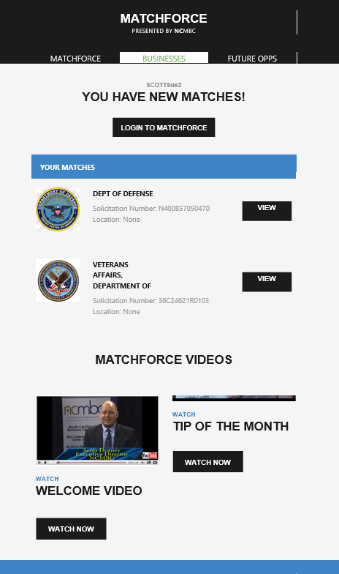
Operations: MatchForce.org
Daily single MatchForce email
Contains up to three matched opportunities with direct links to beta.SAM.gov
Provides link to MatchForce to log in for additional matched opportunities
Contains “Tip of the Month” and “About MatchForce” videos
29

Slide 30
Operations: Tech Transition (DEFTECH)
NCMBC launched NC Defense Technology Transition Office in 2016, partially funded by NC Military Affairs Commission
Scouts for businesses developing tech with military application
Provides info to industry on emerging military requirements, processes and procedures
Assists NC businesses to navigate federal agencies
Conducts emerging technology chats, forums, symposia
30

Slide 31
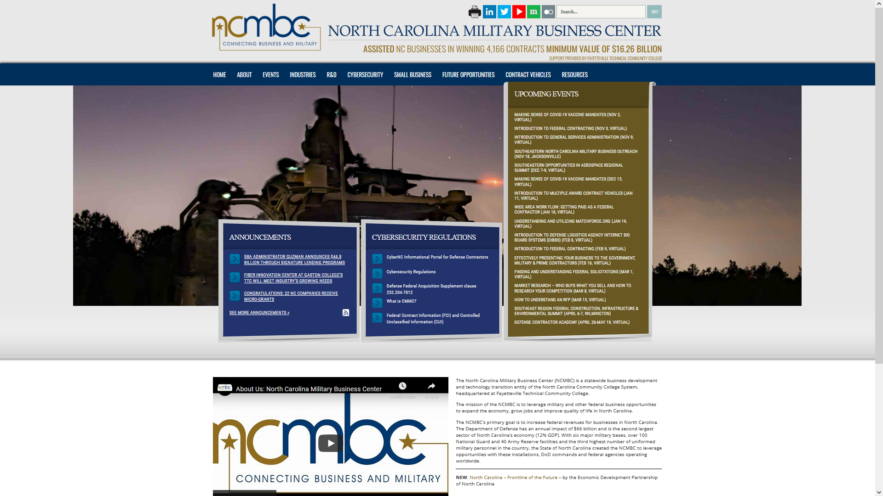
31

Slide 32
Operations: 2021-22 Major Events
SE Region Federal Construction, Infrastructure Summit (OCT 27-28, Virtual)
Small Business Outreach Events (MCIEast/MCBCL NOV 18; SJAFB MAY)
SE Opportunities in Aerospace Regional Summit, SOARS (DEC 6-7, Virtual)
SE Region Federal Construction, Infrastructure Summit (APR 6-7, WIL)
SE Region Federal and Defense Textile Summit, FEDTEX (MAY, Charlotte)
Medical, Biomedical, Human Performance Symposium (JUN 8-9, Chapel Hill)
32

Slide 33
What Your Business Can Do
New to federal business
  Review www.ncmbc.us, Resources, Getting Started checklist
  Register www.MatchForce.org – it’s free, and it works!
  Meet with your NCMBC BD Professional, www.ncmbc.us, About, Contact Us
  Register for events/training, Basic level www.ncmbc.us
Experienced federal contractors
  Register for events/training, intermediate, advanced and Defense Contractor Academies
  Contact your NCMBC BD Professional, www.ncmbc.us, subcontractor support
33

Slide 34
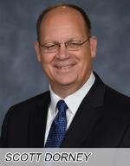
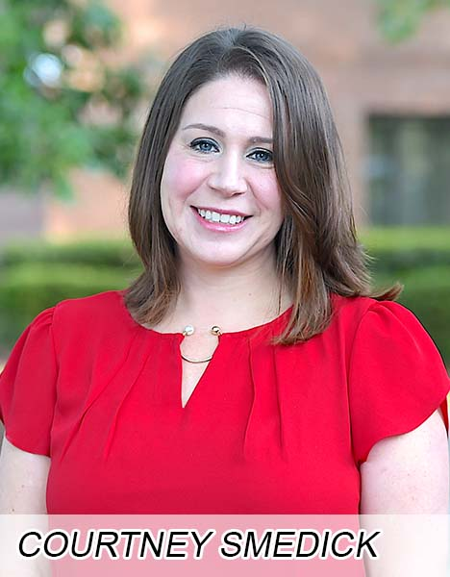
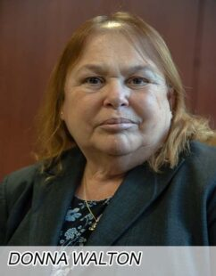
Contact Information – NCMBC.us
Scott Dorney, Executive Director, 910-678-0190, scott@ncmbc.us
Courtney Smedick, Communications and Events Coordinator, 910-678-0193, courtney@ncmbc.us
Donna Walton, BD Professional, 910-459-0147, waltond@ncmbc.us
34

Slide 35
The SBTDC is a business advisory service of The University of ^{North Carolina System} operated in partnership with the U.S. Small Business Administration. sbtdc.org | info@sbtdc.org
35

Slide 36
NC Government Contracting Assistance Program (GCAP)
The North Carolina Government Contracting Assistance Program (GCAP) educates business associates on how to obtain contracts by providing comprehensive assistance in selling products and services to local, state, and federal government agencies.
The core of the Government Contracting Assistance Program is confidential, one-on-one counseling, offered free of charge. The GCAP counselors located throughout North Carolina can help you in numerous ways to navigate your business in government contracting.

Slide 37
How We Help
Determining Suitability for Contracting
  A GCAP counselor can help you determine if your company is ready for the unique challenges associated with federal, state and local contracts. Then we can best position you to succeed.

Slide 38
How We Help
Securing Necessary Registrations
  Your GCAP counselor can educate and guide you through the registration processes with the various contracting databases such as the System for Award Management (SAM), the SBA Dynamic Small Business Search, and other federal, state and local government vendor databases.
  We verify documents for NC DOT, NC DoA, and for VA VOSB/SDVOSB

Slide 39
How We Help
SDB, 8(a), HUBZone, WOSB, SDVOSB and other certifications
  Certain small businesses are eligible for unique opportunities in some government solicitations, called set asides. A GCAP counselor can help you determine if your company is eligible for these certifications and educate and guide you through certification process.

Slide 40
How We Help
Researching Procurement Histories
  What agencies have purchased products or services like yours in the past? Which companies have been awarded these contracts? How much have they been paid? Your GCAP counselor can help you ask the right questions and get the information you need to succeed.

Slide 41
How We Help
  Networking and Training
    Connect with agency buying officers, prime contractors and other businesses during GCAP events and trainings.
  Identifying Bid Opportunities
    We can show you how to register to make sure that you are notified on a daily basis of all government contract opportunities that your company is eligible to bid on.

Slide 42
How We Help
Proposal Preparation
  A GCAP counselor can help you navigate even the most difficult solicitation package, including securing necessary specifications, drawings and pricing considerations.

Slide 43
How We Help
  Contract Performance
  After you’ve received your award, we can educate and guide you with certain contract performance issues, such as:
  Negotiating and interfacing with the agency
  Developing a cost-accounting system
  Bonding and interim financing
  Developing environmental, quality control and accident prevention plans

Slide 44
How We Help
Preparing for Audit
  When it’s time for your contract audit, we can make sure you know what to expect and what you will need to have your documentation in order.

Slide 45
How We Help
Subcontracting
  It is important that you do not neglect the multi-billion dollar secondary market of subcontracting. You should investigate potential opportunities with prime contractors. Many of the federal government’s requirements may be beyond the scope of a single small business and prime contractors are encouraged to subcontract and team with small business concerns. Prime contractors can be found at DoD and SBA’s subcontracting website.

Slide 46
How We Help
Emergency & Disaster Recovery
  There are many contracting opportunities that arise from disaster recovery operations. Emergency Responders need vendors that can clear debris, provide facility support services, furnish necessary supplies, and much more. In the aftermath of a disaster, different aspects of the recovery operations may be led by the federal government through FEMA, state government response programs, city or county emergency response programs, or non-profit organizations like the American Red Cross. We can show you the important steps that you must complete to be prepared to participate in any of these opportunities.

Slide 47
Additional Ways We help:
General Services Administration (GSA) contract preparation and training
Cybersecurity compliance
Understanding accounting system requirements
Ensuring compliance with product packaging and delivery requirements
Invoicing through Wide Area Workflow and other government agencies
Local certifications

Slide 48

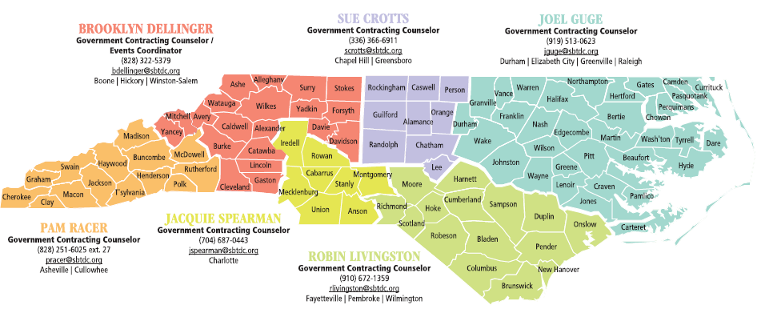

North Carolina Government Contracting Assistance Program (GCAP)
SUE CROTTS
GCAP Counselor
(336) 256-9302
secrotts@ncat.edu
Greensboro | Winston-Salem
JOEL GUGE
GCAP Counselor
(919) 513-0623
jwguge@ncsu.edu
Durham | Elizabeth City | Raleigh
BROOKLYN DELLINGER
GCAP Counselor/Events Coordinator
(828) 322-5379
dellingerbw@appstate.edu
Boone | Hickory
Ashe
Alleghany
Surry
Stokes
Warren
Northampton
Gates
Rockingham Caswell
Person
Vance Granville
Halifax
Hertford
^{Camden} Currituck Pasquotank
Perquimans Chowan
Mitchell Avery
Watauga
Wilkes
Yadkin
Forsyth
Guilford
Orange
Franklin
Bertie
Madison
Yancey
^{Caldwell} Alexander
Iredell
Davie
Alamance
Durham
Wake
Nash
Edgecombe
Burke
Catawba Lincoln
Davidson Rowan
Randolph
Chatham
Wilson
Martin
Wash'ton Tyrrell
Beaufort
Hyde
Dare
Swain
_{Haywood} Buncombe
McDowell
Lee
Johnston
Pitt
Graham
Jackson
Henderson
Polk
T'sylvania
Rutherford
Gaston
Cabarrus
Montgomery Stanly
Moore
Harnett
Wayne
Greene
Cherokee
Macon
Cleveland
Mecklenburg
Cumberland
Lenoir
Craven
Jones
Pamlico
Clay
JACQUIE SPEARMAN
GCAP Counselor
(704) 687-0443
jspearm1@uncc.edu
Charlotte
Union
Anson
Richmond
Scotland
Hoke
Sampson
PAM RACER
GCAP Counselor
(828) 251-6025 ext. 27
pracer@sbtdc.org
Asheville | Cullowhee
Duplin
Onslow
Cartaret
Robeson
Bladen
Pender
ROBIN LIVINGSTON
GCAP Counselor
(910) 672-1359
rlivings@uncfsu.edu Fayetteville | Pembroke
JAMES CHESTNUT
GCAP Counselor
(910) 962-3566
chestnutj@uncw.edu
Greenville | Wilmington
Columbus
New Hanover
Brunswick
JARED WHITCOMB
GCAP Supply Chain Specialist
(704) 351-8146
jhwhitcomb@ncat.edu
Statewide
Specialty Program of the Small Business and Technology Development Center
5 West Hargett Street, Suite 600
Raleigh, NC 27601
(919) 715-7272 or (800) 258-0862 (in NC only)
48

Slide 49
Learn More:
Visit our website: https://sbtdc.org/programs/gcap/
Technical library
On-demand webinars
Events/Workshops

Slide 50
NC SBTDC
The NC GCAP is a specialty program within the North Carolina Small Business and Technology Development Center (SBTDC)
SBTDC is the business and technology extension service of the University of North Carolina system.
Regional Service Centers within 16 institutions.
Operated in partnership with U.S. Small Business Administration

Slide 51
NC SBTDC - Services
General business advice
Financial assistance and analysis
Research
Strategy development
Leadership and employee performance
Specialty programs – GCAP, Technology Commercialization, International Business Development

Slide 52
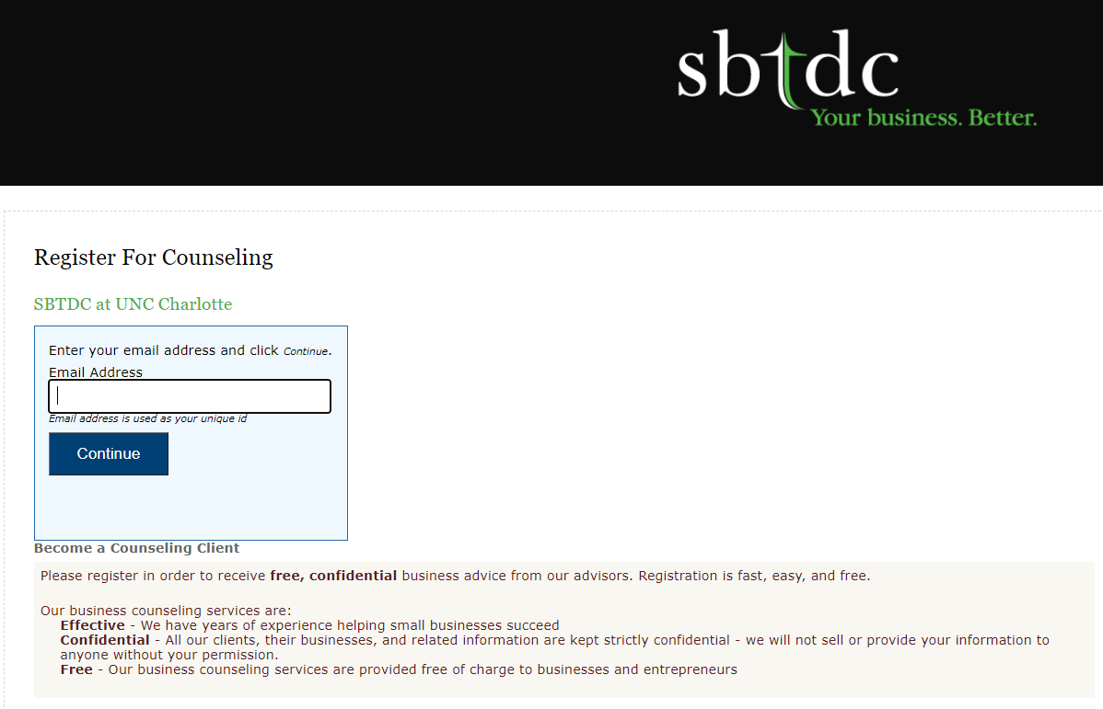
Sign up as a Client
It’s confidential and no-cost, complete a registration form at Register for Counseling
Choose the center that serves your county
You must be a NC registered company

Slide 53

Helping us, Be Better!
We hope that we were able to provide insight on some of the resources that are available to small businesses through the SBTDC and the GCAP program.
Now we are asking how we can be a better resource for you.
Please take the survey: Any Ideas on how to improve?

Slide 54


Jacksonville Onslow Chamber of Commerce
Connecting Military, Business & Community
54

Slide 55
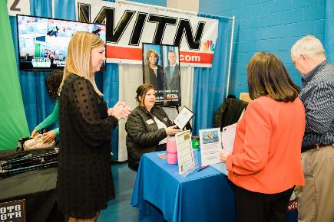
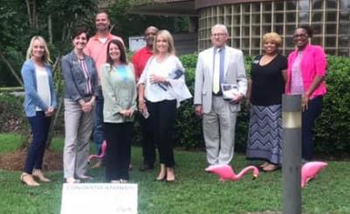
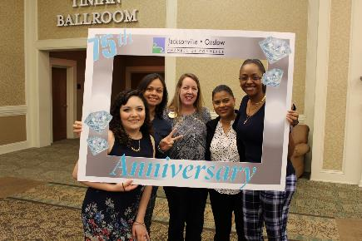
What do we do?
Voluntary organization of business owners and community members
Non-profit organization
501(C) (6)
Not affiliated with city or county government
Serves the local business community with networking opportunities and events
55

Slide 56
Helping You Grow your Business
Promotions
Networking
Training
56

Slide 57
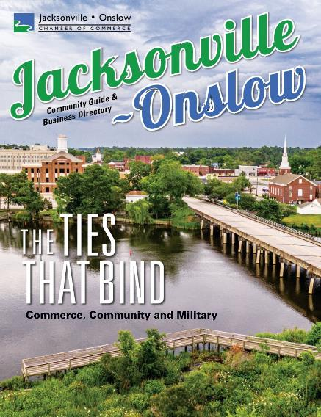
Promotions – getting your business name out there
We refer those looking for reliable businesses to our members
Businesses who join the chamber are published in our membership directory
Refer visitors of the area to businesses who work with us
57

Slide 58
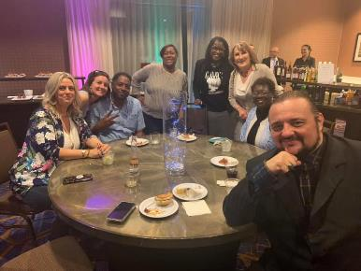
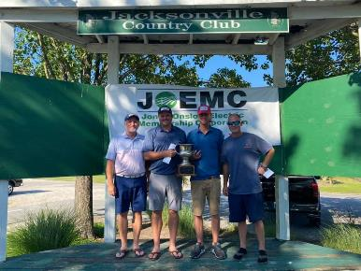
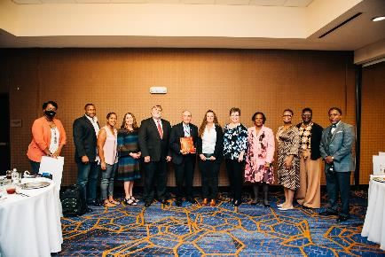
Networking Opportunities
10+ Signature Events Each Year
  Business After Hours, Golf Tournament, Annual Membership Celebration, Christmas Parade, Small Business Week, Minority Entrepreneur Development Week etc.
  Allow members to meet with other established businesses and grow their professional network
58

Slide 59

Training & Resources
Our Small Business Council meets six times a year and offers FREE training on small business issues, such as human resources, sales and profits.
We provide referrals to Coastal Carolina Community College for business owners starting out for free business counseling.
Our resource room offers printed resources on the basics of starting your business.
59

Slide 60
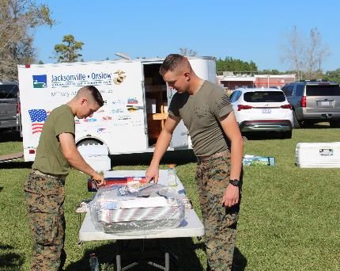
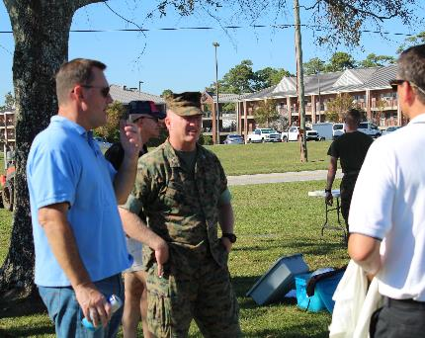
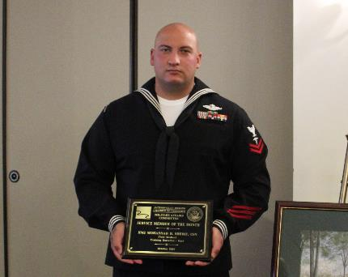
Military Connection
Jacksonville Onslow Military Affairs Committee
60

Slide 61
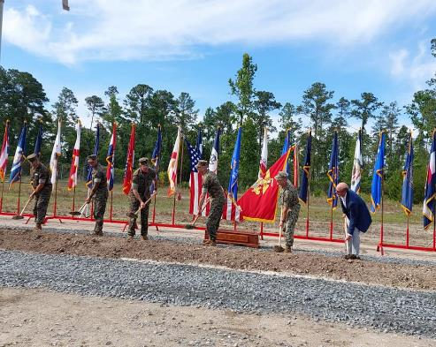
The Mission of Military Affairs (MAC)
To continually improve the relationship between our community and MCB Camp Lejeune
The Oldest Marine Corps military affairs committee in North Carolina
We host monthly dinners honoring the service member of the month
Feed ~2,000 active duty service members each year through MAC fish fries at several locations
Help veteran and civilian business owners make connections with base leaders through networking
61

Slide 62
Takeaways
The Chamber of Commerce can help you connect with other business owners and grow your network
We can help you get established as a veteran-owned business by providing training and resources
We help promote a vibrant business community by providing promotional opportunities for new & established members
We recognize the value of the military in our community and hope to help retiring or transitioning service members reach their business goals
www.jacksonvilleonline.org
62

Slide 63
My information
Kelsey Stiglitz, Military Affairs Manager
Jacksonville Onslow Chamber of Commerce
mac@jacksonvilleonline.org
63

Slide 64
Procuring Office Briefs
CUI
64

Slide 65
Naval Facilities Engineering Systems Command
ROICC Camp Lejeune
NAVFACSYSCOM is the Naval Shore and Expeditionary Systems Command that plans, builds, and maintains sustainable facilities; Delivers environmental, utilities and other base services; acquires and manages expeditionary combat force systems and equipment. ROICC Camp Lejeune Contracting administers Military Construction projects and awards/administers A/E Designs, Studies, Facilities Services, New Construction, Renovation and Repair of Facilities, Buildings, Structures, Roads, Runways, Piers, Bridges, and Utility Systems
We have a variety of tools including several Multiple Award IDIQ Construction contracts covering various disciplines (General Construction, Mechanical/Electrical/Plumbing, Civil/Paving, Roofing), Single Award 8(a) IDIQ contracts, Architect/Engineer IDIQ contracts, Multiple Base Operation Support contracts, and Sealed Bidding
We will be executing new Civil/Paving and Roofing Multiple Award Construction contracts in FY22
Contract Opportunities advertised via Sam.gov
CUI
65

Slide 66

MARSOC
Contracting Brief
MCI-East SmBus Event
(18 November 2021)
LtCol Jonathan Heskett, Chief of Contracts
Mr. Mike Pockette, Deputy Chief of Contracts
MSgt Jorge Rodrigues, Procurement Chief
Marine Forces Special Operations Command (MARFORSOC)
Camp Lejeune, NC
unclassified
66

Slide 67
Agenda
SOF Component Comparison
Condensed MARSOC ‘101’
How and What MARSOC Buys
Recommendations & POCs
Questions
unclassified
67
Notes:
Different size/impact of Components & MARSOC (small).
101 = Quick Overview on MARSOC structure/commands.
Few recommendations & POC info.
Then open it up to any Qs. (or stop me during presentation).

Slide 68
USSOCOM Components
US Army
US Air Force
FY21 Procurements:
USSOCOM $5.4B
MARSOC $29.7M
US Marines
US Navy
MARSOC Contracting is not: MCI-East (MCB) or NavFac (ROICC)
USSOCOM Procurement Authority, and SOFARS
unclassified
68
Notes:
USSOCOM FY21 down slightly from $5.5B FY20
MARSOC up from $24.3M for FY20…
Graphic shows different size of the Service Components w/in USSOCOM.
US ARMY – 54% (Army heavy); USAF – 26%; USN – 15%
USMC – 5% (similar to DoD as a whole).
(Marines like to say – You get a whole lot for nickel!).
**Proc Dollars even less; Less than 1% SOF total (0.5%)**
MARSOC Only Support – Only MarFor w/ Contracting Office.

Slide 69





MARSOC Overview
MARSOC
MRTC
MRR
MRSG
(School)
(Operators)
(Support)
Always Faithful, Always Forward -‘Silent Warriors’
(Today will be Different…)
unclassified
69
Notes:
School: 18 Months; Opr 3 to 4 years (5-Year Tours)
Spt: Combat Spt (MPC, JTAC, Eng-IED/EOD) & CSS (Sup/MT/Log/Med).
Special Ops = DA (Direct Action), SR (SpecRecon),
COIN (Counterinsurgency), CT (Counterterrorism),
FID (Foreign Internal Defense), SFA (SecurityForceAssist),
CWMD (CounterWpnsMassDestruction).
Motto = Always Faithful, Always Forward – ‘Silent Warriors’
(Branding – ‘Today will be Different’)

Slide 70
How MARSOC Buys
Small Office: 16 personnel (1 OIC, 8 Enlisted, 7 Civilians)
Only support MARFORSOC
Competition (+80%)
Small Business Goals
Large Multiple Award Contracts
  Managed by USSOCOM HQ in Tampa, FL
  Pre competed and awarded (Enterprise support)
  USSOCOM SOF Core Support – services & training support
GSA e-Buy / OASIS, Navy GWAC, and NASA SEWP
  IT, Computers/Accessories, Multi-Functional Devices, Cell Phs, Services, etc.
System for Award Management (SAM)/FBO (FedBizOpps)
  Services/Training: Comms, Intel, Medical, SigInt, ISR, and Exercise Support
  Products/Supplies: Equipment/Materials (IT, Shredders, Dive, Canine, Vet, etc.)
Oral RFQs
  Low dollar values, quick turns done over phone and or via email
Bottom Line: We use the same procurement techniques as everyone else…but we are not like everyone else
unclassified
70
Notes:
USSOCOM Divisions and PEOs support Enterprise-wide (PORs – Program-of-Records).
HQ IDIQs used: SITEC (SOF IT Enterprise K), SOFLO (Language Office), & SWMS-B (7/8 Awds).
(SWMS-B supports: HQ POTFF, Recruiting, Assess & Select; MRTC; and MRR)
Awarded to Large and Small Business based on Acq Plan/Strategy.
Seek Maximum Competition; usually ~+75%.
Goals: SmBus 26%; SDB 5%; SDVOSB 3%; WOSB 2%; HUBZone1%
**Achieved All in FY18**
SEWP - Solutions for Enterprise-Wide Procurement (pronounced 'soup')
A multi-award Government-Wide Acquisition Contract (GWAC) focused on commercial IT products and product based services.

Slide 71
What MARSOC Buys
Services (~ 90% of our actions)
  SOF Training support services (Special Skills, Exercises, ISR, MPC, Manpower augmentation)
  Mostly done via large SOCOM contracts…but not all (GSA and SAM / FBO)
Supplies (~ 10% of our actions)
  Mixed bag: IT – Computers/hard drives, shredders, books, etc.
  Methods of purchase: Oral, GSA, SEWP, FBO.
Construction (none)
Bottom Line: We use the same procuring techniques as everyone else…but we are not like everyone else
unclassified
71
Notes:
Need to Pull PD2 data for NC Firms…
USSOCOM is about 60% Services and 40% Products (Supplies/Equipment/Materials)
Reminder re Construction = ROICC/NAVFAC is procuring activity.
ISR: Intel, Surveil, Recon. MPC: MultiPurposeCanine (MPK9)

Slide 72
Recommendations
Send us your ‘slick sheet’ if you think you are interested in supporting MARFORSOC
  May be able to work you into RFQs or market research
  marsoc.contracting@socom.mil
Seek out SOF Core Support prime contractors for local subcontract opportunities.
  Internet search for: “USSOCOM Core Support services contract awardees”
    46 Multiple award IDIQs - $950B services ceiling cap
Seek access to GWACs (e.g., GSA schedules & SEWP V contracts)
Monitor SAM / FBO and GWACs - GSA/SEWP/etc. H92257 is MARSOC
unclassified
72
Notes:
Slick Sheet = Capabilities Brief/Doc/Stmt.
Your Marketing Brochure, Tri-fold, etc.
Google shows 32 SWMS-B vendors (Orig 8 + 24); $450M.
GWACs = Government-Wide Acquisition Contracts.

Slide 73
MARSOC POCs
LtCol Jonathan Heskett, Chief of Contracts: jonathan.d.heskett.mil@socom.mil (910-440-0719)
Mr. Mike Pockette, Deputy Chief of Contracts: michael.pockette@socom.mil (910-440-0777)
MSgt Jorge Rodriguez, Procurement Chief: jorge.r.Rodriguez.mil@socom.mil (910-440-0875)
Mr. Sam Williams, Contracting Officer: samuel.williams1@socom.mil (910-440-0773)
unclassified
73

Slide 74
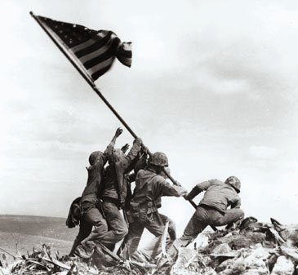
Questions?
“Marines are who we are,
Special Operations are what we do”
unclassified
74

Slide 75


Naval Medical Center
Camp Lejeune
Melissa Carpenter
Contracting Officer
18 November 2021
The Medical Center of the Marine Corps
75

Slide 76
Topics
Who we are
What we purchase
Mandatory sources
Methods of procurement
Where to find our solicitations
The Medical Center of the Marine Corps
76

Slide 77
Naval Medical Center Camp Lejeune
Level III Trauma Center
Current staff of 1,184 active duty, 723 civilians, and 648 contractors
Serves a beneficiary population of 141,000
Inpatient care: Medical Surgical Unit, ICU, Neonatal ICU, Mental Health Inpatient, Labor and Delivery
Outpatient care: Internal Medicine, Preventive Medicine, Occupational Health, Ancillary Services and Dental Services
The Medical Center of the Marine Corps
77

Slide 78
What We Purchased in 2021
Medical equipment
Medical instruments
Medical consumables
Skin grafts
Calibrating services
Equipment maintenance plans and warranties
Medically related and non-medically related personal services
Furniture
Furniture relocating/reconfiguring/design services
Software
Software licenses
Website subscriptions
Flags
Ball caps
HVAC Filters
Storage cabinets
Kiosks
Communication equipment such as radios
Display boards
Reverse Osmosis Purifier Systems
Spill kits
Ergonomic desk accessories
Refrigerators/freezers
TVs and DVD players
Spot coolers
Tools
Barcode Scanners
Bike lockers
The Medical Center of the Marine Corps
78

Slide 79
Mandatory Sources
Some degree of regulation regarding sources of supply
  ECAT (Electronic Catalog) and Prime Vendor
    mandated by Bureau of Medicine and Surgery for procurement of medical equipment, accessories, and consumables
  Navy Furniture BPA
    mandated by Department of the Navy for procurement of common office and dormitory furniture
    DLA Document Services
    mandated by Department of the Navy for printing/duplication services and rental of duplication equipment
The Medical Center of the Marine Corps
79

Slide 80
DLA: Prime Vendor
Defense Logistics Agency manages Prime Vendor contracts
This source is screened FIRST for all procurement requests at NMCCL
Information about the MedSurg Prime Vendor Program available at:
  https://www.medical.dla.mil/ - choose the Prime Vendor Program tab at the top
Distribution and Pricing Agreement (DAPA) required to participate in program. Apply for a DAPA at the DLA site.
Two types of DAPAs for the Prime Vendor program:
  General DAPA: sutures, bandages, syringes, surgical devices, hospital linens and gowns, etc.
  Equipment DAPA: infusion pumps, suction apparatus, pulse dosimeters, exam tables, hospital carts, etc.
The Medical Center of the Marine Corps
80

Slide 81
DLA: ECAT
Defense Logistics Agency manages Electronic Catalog (ECAT) contracts
This source is screened FIRST for all procurement requests at NMCCL
Information about the ECAT Program available at:
  https://www.medical.dla.mil/ - choose the ECAT tab at the top
Programs offered through ECAT: dental, equipment, laboratory, optical, etc.
The Medical Center of the Marine Corps
81

Slide 82
Methods of Procurement
Upon conclusion of mandatory sources screening, procurement is made via contract or Government Commercial Purchase Card (GCPC), based on dollar value of the procurement.
The Medical Center of the Marine Corps
82

Slide 83
Procurements <Micro-Purchase Threshold
GCPC is method of payment for procurements under the following thresholds:
  $2,000 for construction
  $2,500 for services
  $10,000 for supplies
The Medical Center of the Marine Corps
83

Slide 84
Procurements >Micro-Purchase Threshold
Government contract is method of procurement for requirements exceeding thresholds on previous slide
Must have active System for Award Management (SAM) registration
Invoices are submitted/paid through Wide Area Workflow (WAWF)
  Small Business Professional reviews recommended course of action (set-aside, full and open competition, brand name/sole source exclusions) for each procurement
The Medical Center of the Marine Corps
84

Slide 85
Where We Solicit Our Opportunities
SAM.gov
GSA eBuy
NASA SEWP
The Medical Center of the Marine Corps
85

Slide 86
DLA AVIATION QAX CHERRY POINT
IN SUPPORT OF FLEET READINESS CENTER EAST (FRCE)
Larry Kemp
Anita Smith
Supervisory Contract Specialists
DLA Aviation Cherry Point, NC
86

Slide 87
DLA AVIATION QAXCC
IN SUPPORT OF FLEET READINESS CENTER EAST (FRCE)
DLA QAX Cherry Point Procurement Team provides support to our industrial customer, Fleet Readiness Center East (FRCE). We develop, coordinate, facilitate, manage and plan the daily acquisition of aircraft parts, components, raw materials, and government supplies to support our customer’s organizational goals and objectives. Our primary and ultimate goal is support of the warfighter!
Government Points of Entry:
DLA Internet Bid Board System (DIBBS)
Web-based application that allows you to search for, view, and submit secure quotes for
DLA solicitations allows users to search and view awards, and other procurement
information www.dibbs.bsm.dla.mil
Beta.SAM Opportunities
Federal Agencies publish their solicitations providing detailed information on how and when
vendors should respond.
Utilize to search, monitor, and retrieve potential opportunities matching the goods and services
they provide. beta.SAM.gov
Source: Director’s Office DLA Slide Template
As of August 26, 2020

Slide 88


DLA Aviation
Provides global airpower supply solutions
CLASS IX
Procurement Organizations
Commodity | Supply Class
Aircraft Hydraulic, Vacuum and De-icing Components | 1650
Aircraft Landing Gear Components | 1620
Airframe Structural Components | 1560
Bearings, Plain, Un-mounted | 3120
Bushings, Rings, Shims and Spacers | 5365
Cable, Cord and Wire Assemblies | 5995
Chain and Wire Rope | 4010
Electrical Hardware, Supplies | 5975
Engine Electrical Systems Components, Aircraft | 2925
Gas Turbines, Jet Engine and Components, Aircraft | 2840
Richmond
Fleet Readiness Centers
  San Diego
  Jacksonville
  Cherry Point
Depot Level Reparable sites
  Ogden
  Warner Robins
  Huntsville
  Oklahoma
  Philadelphia
88
FOR OFFICIAL USE ONLY

Slide 89

Aviation Small Business Performance
FY19 Highlights:
Exceeded goal (21.5% versus 18%)
SB dollars highest ever at Aviation ($1.9B)
Dollar increases in all subcategories
89

Slide 90
Solicitation Opportunities
DLA Internet Bid Board System (DIBBS)
Web-based application that allows you to search for, view, and submit secure quotes for DLA solicitations
allows users to search and view awards, and other procurement information www.dibbs.bsm.dla.mil
Beta.SAM Opportunities
Federal Agencies publish their solicitations providing detailed information on how and when vendors should respond.
Utilize to search, monitor, and retrieve potential opportunities matching the goods and services they provide. beta.SAM.gov
Site | Opportunities
Richmond/FRCs | DIBBS (www.dibbs.dla.mil)
DLRs | Beta.SAM (beta.SAM.gov)
You can search using the DODAACs below in beta.SAM.gov
Site | DODAACs
Richmond | SPE4***
Huntsville | SPRRA1 | SPRRA2
Ogden | SPRHA1 | SPRHA2 | SPRHA3 | SPRHA4
OKC | SPRTA1
Philadelphia | SPM5A3 | SPM5AG | SPRPA1
Warner Robins | SPRWA1 | SPRWA8
San Diego FRC | SPEFA1
Jacksonville FRC | SPEFA3 | SPEFA4
Cherry Point FRC | SPEFA5 | SPEFA6
FOR OFFICIAL USE ONLY

Slide 91


Our “Asks”
Where we could use your help…
DLA AVIATION SMALL BUSINESS PROGRAMS
Please use below email address for all inquiries.
Email: dlaavnsmallbus@dla.mil
Website: https://www.dla.mil/SmallBusiness/
Transparency & open communication
Increasing material availability
Reducing unfilled backorders
Timeliness of goods/services
Overcoming unexpected demand spikes
Parts & distributor accountability
91

Slide 92
DIBBS Overview
Larry Kemp
Anita Smith
Supervisory Contract Specialists
DLA Aviation – Cherry Point, NC

Slide 93
Steps to Doing Business with DLA
Checklist For Success
Understand DLA - Review the detailed guide, "Small Business Overview for Vendors," to learn more about DLA. Explore the DLA small business webiste;32 pages; includes how to find opps; subcontracting and post award information
Obtain a DUNS Number - A DUNS number is a nine-digit number that uniquely identifies your business. Establish your DUNS number at the Dun & Bradstreet website or call 1-800-700-2733.
Register in System for Award Management (SAM) - Create a user account and register at the SAM website.
Visit your local Procurement Technical Assistance Center (PTAC) - PTACs assist businesses in pursuit of a federal government contract. Find your local PTAC. Local resource to assist SBs in pursuing and performing on federal contacts. Usually at no cost.
Vendors must be registered in SAM to acquire a DIBBS account. DIBBS completes certain registration information by accessing SAM data.

Slide 94
DLA Internet Bid Board
DIBBS is a web-based application.
Enables the supplier community to search for, view, and
submit secure quotes on Request for Quotations
(RFQs) for DLA items of supply.
Users can also search for, view, and upload proposals
for Requests for Proposal (RFPs) and Invitations for
Bid (IFB).
Users can view awards and other procurement information.
Users can submit Post Award Requests (PARs).

Slide 95
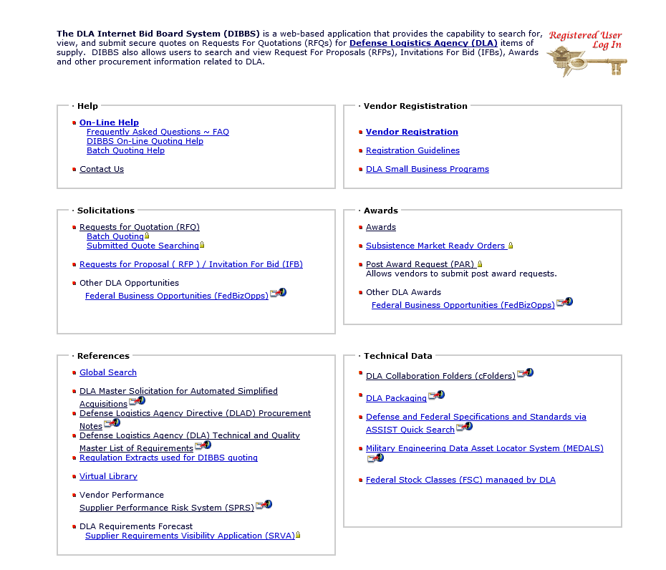
DIBBS Home Page (www.dibbs.dla.mil)
Registration in both and SAM and DIBBS is required to receive a login account and a password.
Detailed instructions
for registration can be found on the DIBBS Help Page at: https://www.dibbs.bsm.dla.mil/
Registration allows the supplier to
conduct transactions over the restricted portions of DIBBS (e.g. submitting electronic
quotes on RFQs)
Input FSCs/NSNs for Vendor Directed Notifications
.

Slide 96
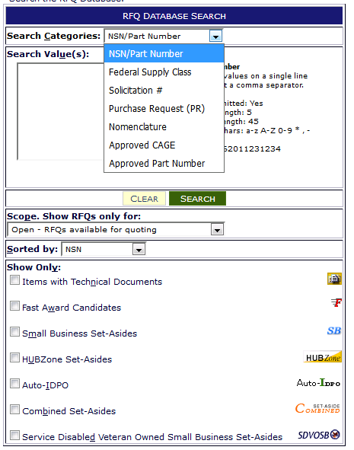
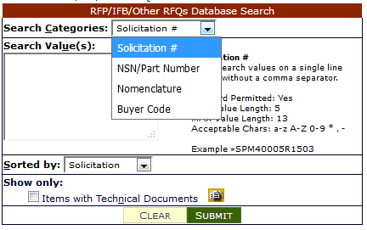
Solicitation Searches
Request for Quote
(Under $250K)
Request for Proposal
(Over $250K)
https://www.dibbs.bsm.dla.mil/RFP
https://www.dibbs.bsm.dla.mil/RFQ

Slide 97
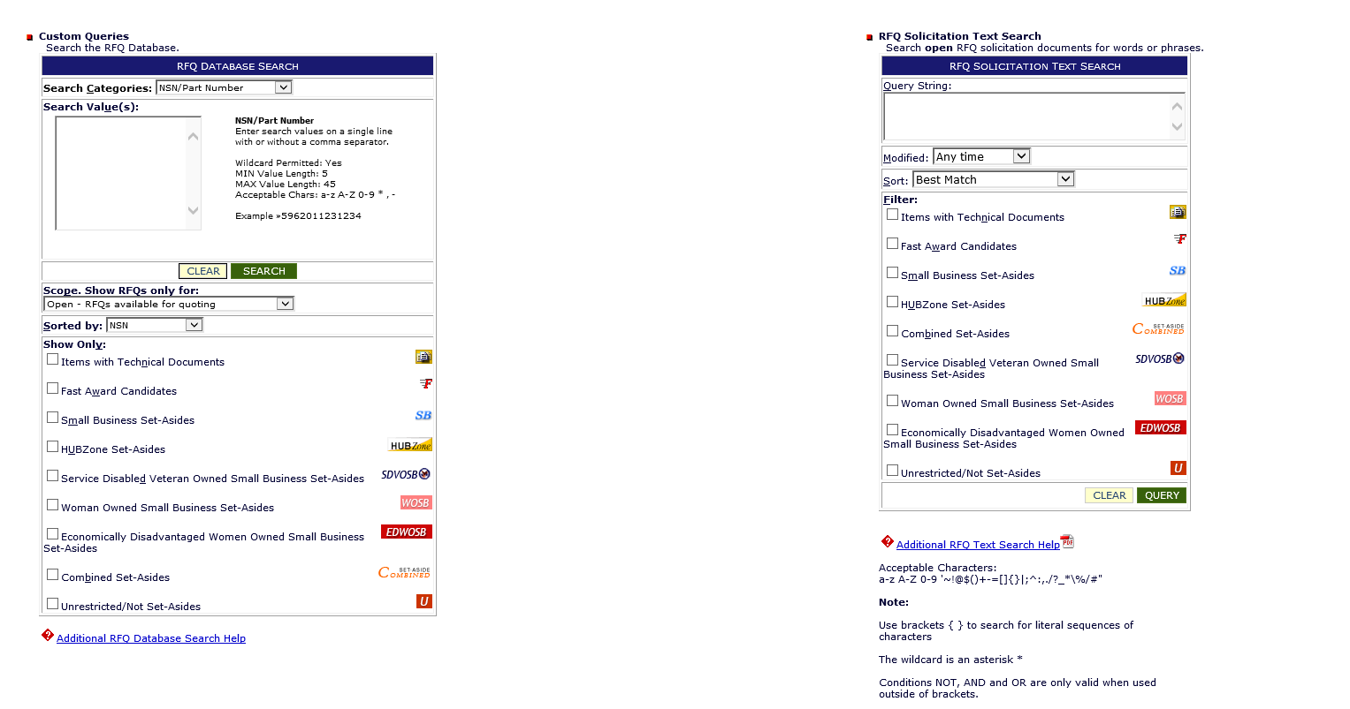
DIBBS Searches (con’td)
Show Onlys Limit Searches to Criteria Listed:

Slide 98
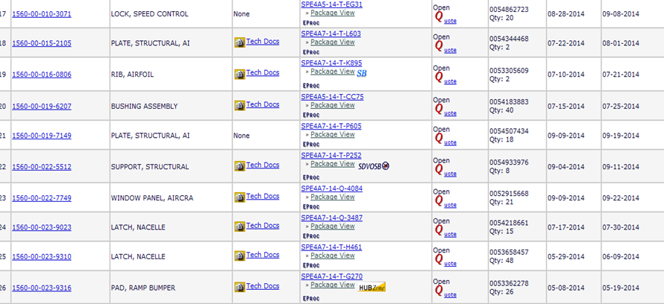
Solicitation Listing
NSN
Item Name
RFQ Number
Qty
Closing Date
Click Here to Quote
Clicking on the NSN will give a quick snapshot if the item is competitive or part numbered
Small Business Set Aside
SDVOSB Set Aside
Tech Documents
HUBZone Set Aside

Slide 99
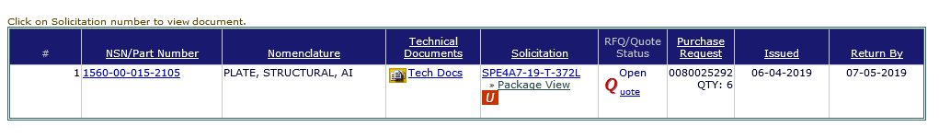
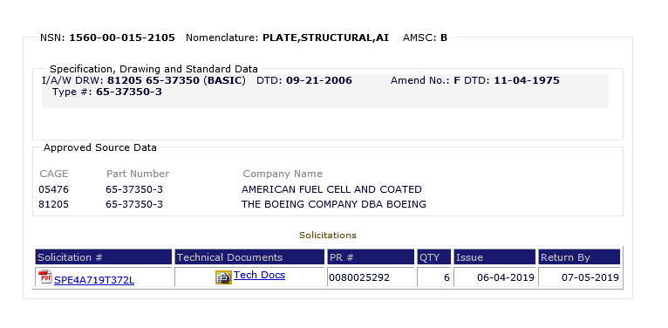
NSN Information
NSN Hyperlink
AMSC Code
Solicitation i/a/w approved sources and part numbers

Slide 100
cFolders
You can use your search results from DIBBS to access the cFolders system where drawings are provided.
The first time you access cFolders you will use your DIBBS User ID and password to log in.
When you enter your DIBBS (BSM) User ID and password, you will receive a "change password" prompt

Slide 101
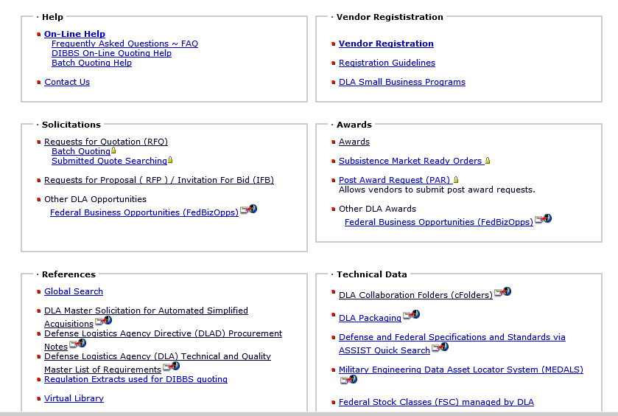
Post Award Requests
WAR FIRST
•A Post Award Request (PAR) is an electronic request for post-award action or information on an award that can be created and submitted by suppliers via DIBBS.
•PARs allow suppliers to communicate their requests for post-award action or information directly to the Post Award Administrator.
•PARs provide tracking visibility into post-award actions and status.
•Previous methods of processing and tracking post-award actions (email, phone, fax, etc.) should be managed by PARs to provide
transparent tracking.

Slide 102
DIBBS FAQ/Help Websites
  cFolder & cFolder Customer Support:
  DLA Product Data Customer Service Help Line
  1-804-279-3477
DIBBS Issues
https://www.dibbs.bsm.dla.mil/feedback/

Slide 103


Navigating GSA Overview
Janice Zeigler- Industry Liaison
GSA FAS R4 Customer and Stakeholder Engagement Division (CASE)
Brittany Black- Customer Service Director
GSA FAS R4 Customer and Stakeholder Engagement Division (CASE)
U.S. General Services Administration
103

Slide 104

Doing Business With GSA
GSA is America's only source solely dedicated to procuring goods and services for government. As an integral part of GSA, the Federal Acquisition Service (FAS) possesses unrivaled capability to deliver comprehensive products and services across government at the best value possible. FAS offers a continuum of innovative solutions and services:
Products and Services
Technology
Motor Vehicle Management
Transportation
Travel
Procurement and Online Acquisition Tools
MAS (Multiple Award Schedule) Transformation -
-FAS is committed to providing our stakeholder community with a MAS program that will address current market conditions and provide government with a streamlined, value-based contracting solution that continues to save time and money well into the future. MAS Transformation is focused on these outcomes.
GSA Forecast of Contracting Opportunities
It's easy to find small business contracting opportunities thanks to the Forecast of Contracting Opportunities Tool.
The Forecast of Contracting Opportunities Tool provides information on expected federal contracting opportunities. The tool assists with acquisition planning by helping vendors learn about potential prime contracting opportunities early in the process. Users can easily filter the data by agency, location (place of performance), NAICS Code, contract type, and more. This link goes to the GSA Acquisition Gateway.
https://www.gsa.gov/buying-selling/forecast-of-contracting-opportunities
104

Slide 105


AN OVERVIEW FOR NEW VENDORS
About GSA Schedules
GSA offers over 50 million supplies and services
MAS Consolidation- Offering 12 Categories
Over 14,500 Schedule contracts
80% of GSA MAS contracts go to small businesses
$50 billion total annual spend or 10% of overall federal procurement spending
The GSA Schedules program is the premier acquisition vehicle in government, with approximately $50 billion a year in spending or 10 percent (10%) of overall federal procurement spending.
105

Slide 106

Questions?
Janice Zeigler- Industry Liaison
Jan.Zeigler@gsa.gov- (803) 626-5244
Brittany Black- NC Customer Service Director
brittany.black@gsa.gov -(910) 813-8262
106
Notes:
You can also contact me, your local Small Business Specialist as well.

Slide 107
II MEF
Expeditionary Contracting Platoon (ECP)
Vendor Outreach Presentation
Presented by:
GySgt Richard Aguila

Slide 108
Order and Regulations
Mission
Authority
Area Of Responsibility
Requirements
Contractor Support
Agenda

Slide 109
Orders and Regulations
FAR
DFAR
NMCARS
MAPPS
JP 4-10 OCS
U.S. Army FOO handbook 09-16
MCO 4200.34 (CCF)
II MEF Order 4200
ECP SOP
ECP Customer Handbook

Slide 110
Mission: When Directed, Provide comprehensive expeditionary contracting support to any size Marine Air Ground Task Force or augmentation to a joint contracting agency. This includes contracting and purchasing essential supplies and services that are not readily available through normal logistic channels or Host-Nation Support throughout the full range of military operations (ROMO).
Mission

Slide 111
The ECP’s contracting authority is limited to: contracts executed in support of exercises and deployments for Joint Force or MAGTF unit operations where the performance of the contract is to be executed in support of exercises or operations being conducted outside the continental United States. The ECP may provide contracting support for MAGTF level unit exercises that take place in the continental United States, where garrison support is not provided.
Contracting Authority

Slide 112
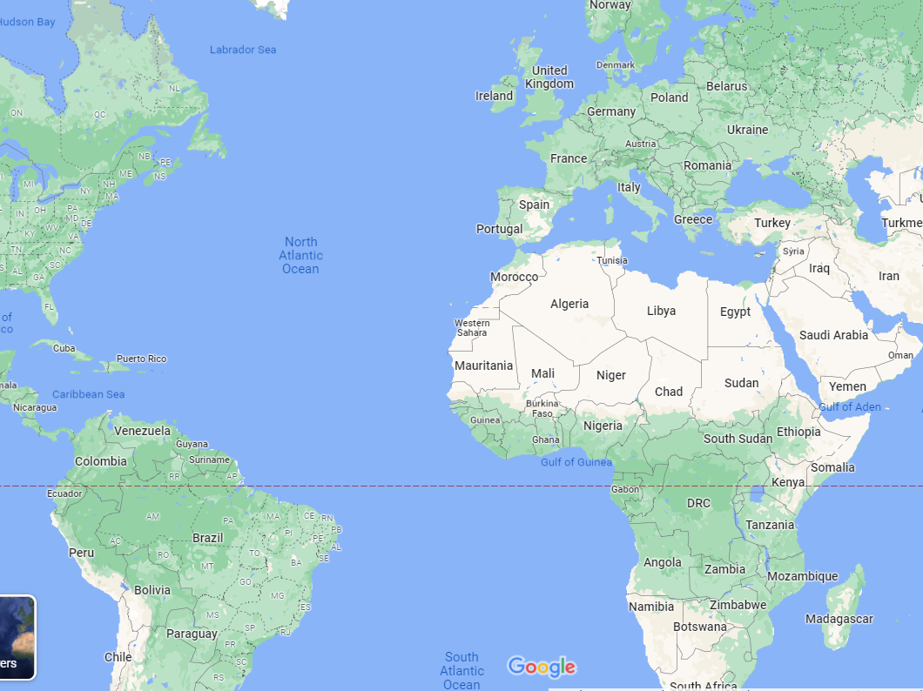
Area Of Responsibility

Slide 113
Portable Toilets and Handwashing Stations
Variety of Rental Vehicles such as sedans, trucks, and vans
Heavy Equipment such as forklifts, lowboys, and cranes
Interpreters
Food & water
Lodging & shelter
Base operating services such as laundry, waste disposal & utilities
Fuel
Enduring Requirements

Slide 114
Short-fused requirements with changes
Looking for more general contractors in the vendor pool
Contractor Support

Slide 115
GySgt Richard Aguila: richard.aguila@usmc.mil
910-451-1517
Points of Contact

Slide 116
Marine Corps Installations East
Regional Contracting Office
CUI
116

Slide 117
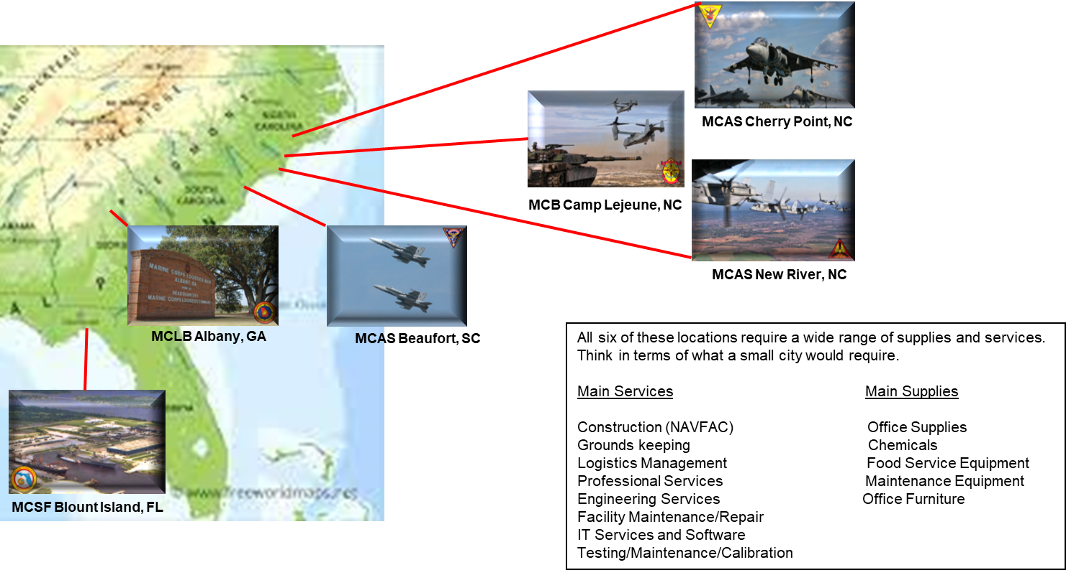
Marine Corps Installations East
Structure
CUI
6
117

Slide 118
Marine Corps Installations East
Regional Contracting Office
RCO uses Federal contracting methods and the Government-Wide Commercial Purchase Card (GCPC) to procure a wide variety of services in support of base operations and the operating forces. RCO does not do construction contracts. Construction contracts are supported by Naval Facilities Command (NAVFAC).
How the RCO solicits requirements: sam.gov, GSA EBuy, NASA SEWP)
Forecasted Requirements: (will show from business website)
No Small Business Responses:
Award Supply/Service
M6700121P1069 Heat Exchangers (Supply)
M6700121D0001 LP Gas Delivery and Testing
M6700121P1111 Small Engine Repair
M6700121P1116 Harness Testing and Repair
M6700121P1028 Refrigerator
M6700121P1200 Lubrication Services
Forklift Maintenance
Reverse Osmosis Water Purification Unit Maintenance
Aircraft Heat Exchanger Testing
CUI
118
9
116

Slide 119
Other Procuring Offices
Marine Corps Community Services (MCCS)
Basic tenants website (Business Partners - Marine Corps Community (usmc-mccs.org) provides information for parties interested in working with the Marine Corps Exchanges (handled via HQMC) and local agencies. Not a centralized system, vendors have to work with each individual Contracting Office to get on a mailing list for supplies/services.
MCCS Point of Contact: Christopher.Alger@usmc-mccs.org
Defense Commissary Activity
Business with DeCA website https://www.commissaries.com/our-agency/business-with-deca/small-business provides information for parties interested in working with commissaries. Procurement authority is at DeCA headquarters in Fort Lee, Virginia.
Government Commercial Purchase Card
There are several hundred cardholders on the base purchasing supplies/services daily. The main points you need to know: (1) ensure you can use a credit card, (2) ensure you are talking to/making a transaction with an actual cardholder, (3) no third-party payments (PayPal, Venmo), (4) the GCPC office can only assist you with actual payment issues.
GCPC Agency Program Coordinator: John Outlaw, john.outlaw@usmc.mil
CUI
119

Slide 120
Other Discussion Points
Barriers to doing Business
  Results from 25 Oct 2021 Department of Defense Survey
  Transparency/Forecasting
  Impacts of Government Wide Contracts
  NAICS and Business Size
Cyber Maturity Model Certification
Supply Chain/Labor Impacts
CUI
120
9

Slide 121
Contractor Base Access
Camp Lejeune
Stone Bay (MAROSC)
The Contractor Vetting Office is located in Bldg. 818 adjacent to the Camp Lejeune Main Gate on Holcomb Blvd, just off N.C. Highway 24. The CVO is open Monday through Friday from 6 a.m. to 2 p.m. and closed on weekends and holidays.
Contractor Vetting Office - Appointments: 910-451-8558
Contractor Vetting Office - Questions: 910-451-3220
Taxi Vetting: 910-449-4208
Email: lejeunecontractorvetting@usmc.mil
https://www.Lejeune.marines.mil/Base-Access/
Contractors approved for access will receive either a DBIDS credential or temporary pass, depending upon the length of time they require access to the installation. A DBIDS credential is issued to individuals requiring access for 61 days or more. A temporary pass is issued to individuals requiring access for 60 days or less. Contract specifications determine the length of pass.
Contractors will report to the Contractor Vetting Office (CVO) to confirm their access requirements, undergo a background check and receive their credential/pass.
Department of Defense affiliated personnel visiting MARSOC must
Submit a Visit Authorization Request (VAR) through their Security Manager (DoD) or Facility Security Officer (Industry).
This is done through the Joint Personnel Adjudication System (JPAS) identifying the MARSOC sponsor’s name & phone number as the point of contact.
Submit VAR to the following MARSOC SMO:
Collateral: 209006
SCI: 209000943
As a contractor you must work through your Government point of contact to ensure you have proper base access.
CUI
121
11

Slide 122
Thank you for your participation!!
CUI
1
122

